Slide 1
The Croft Primary School Internet Safety Presentation

Slide 2
What is online safety?
Online Safety is being aware of the nature of the possible threats that you and your children could encounter whilst engaging in activity through the Internet
It is important to understand that online safety is more about communication skills than technology

Slide 3
What do we have to be concerned about?
The Internet is an exciting and integral part of the modern world, and can be an exceptional tool for learning. However, using the Internet is also fraught with risk, and keeping children safe when they're online and/or using social media platforms is of paramount importance.
Whether it's dealing with online bullying, protecting personal data, or avoiding viruses and inappropriate materials, we strongly believe that promoting Internet safety is crucial in helping young people protect themselves online.

Slide 4
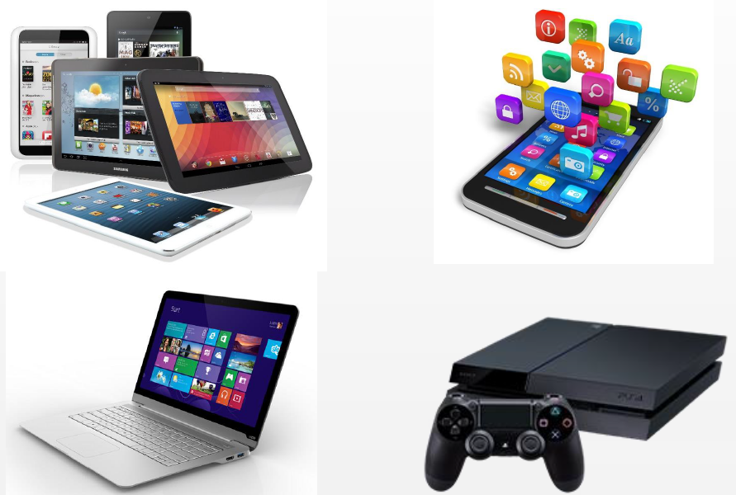
How children access the internet?
No longer do we have one DESK TOP computer to share between the family where you can see what everyone is doing.
In the modern world children can access the internet in a number of ways which does not require a parents involvement or their permission.
Tablets,
Lap tops,
Smart phones,
Gaming systems.

Slide 5
Statistics
Smartphones
Most children in Britain have their own smartphones before they turn 12.
What % of six-year-olds already have one
10%
2. How many are allowed the use of a family device.
49%
3. The number of children with a phone rises sharply after the age of nine or ten, and how many 12-year-olds are entrusted with their own device?
88%
4. By the age of 17 only what % of children are without their own phone?
4%

Slide 6
More statistics
Tablets and iPads
At age six, 85% of children say they have access to a tablet at home, and what % have their own.
40%
2. Tablet ownership peaks and begins to plateau around the age of 10 to 12, which is around the same age that we see the dramatic rise in smart phone ownership.
Computers and laptops
When it comes to laptops and computers, British kids have to wait a lot longer to get their own - but most have access to a family device from an equally young age.
Only 5% of children have their own laptop at age six, making it the least-owned of the technology.
PC ownership among children is fairly low until they begin secondary school as they reach the ages of 10 to 11.
There is another slight jump in ownership as children graduate from secondary education into college and sixth forms, and by age 17, only 4% say they don’t have a computer.

Slide 7
What they use their devices for
Were 96% or 76% of children likely to watch TV programmes on video-on-demand (VoD) rather than live TV.
Did 70% or 50% of 5-15s play games online in 2021. Were boys or girls more likely?
Did 30% or 55% of 5-15s used social media sites or apps?
87% or 67% of 12-15s used social media sites or apps?
The range of sites and apps used remains diverse; around a third of 5-15s used Instagram, Snapchat and Facebook.

Slide 8
Social media sites
How old do you have to be?
Face book 11 or 13
Twitter 11 or 13
Snap chat 11 or 13
You tube 9 or 13
WhatsApp 11 or 16
SMS no age limit or 9
Xbox live 13 or 18
Instagram 11 or 13

Slide 10
Alternative social media sites for younger children
Snapkidz (apple only at the moment)
Is a a non-social, photo app for kids under 13
Grom Social?
The app allows kids to meet other kids like themselves by connecting via chat messaging, creating videos, watching socials and sharing posts.
PlayKids Talk?
Is an internationally-acclaimed platform with cartoons, books, and activities for kids aged 2 to 8. With the PlayKids Talk app, kids can access activities, games and content such as videos. Parents can also manage kid’s contacts, authorise camera and microphone access
Kidzworld
Is a child-friendly, private and fully moderated kids social network where kids can meet new friends in the forums, use the childsafe messenger for private messages, find the latest kids safe news about their favourite teen celebs, play cool games and more.

Slide 11
Age appropriate games

Slide 12
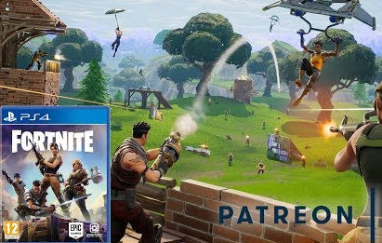
Popular games with age ratings
10+
12 Would you let your 5-11
year old watch a 12 film?
10+
18

Slide 13
Popular games with age ratings
9+
E For everyone (10+ Fantasy violence)
E For everyone
3+

Slide 14
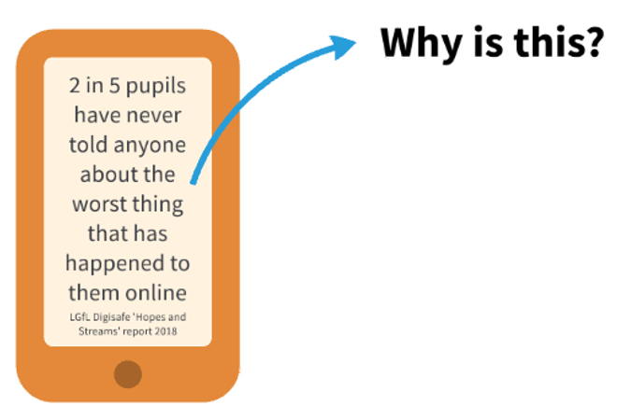
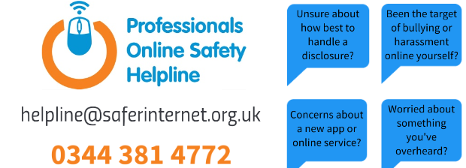

Slide 15
We are all concerned about our children and will deal with any difficulties they have but we also have a duty to report incidents to the relevant parties and to do this you need to follow the sites online reporting procedures. If They don’t know about it they can’t put restraints in place

Slide 16
Messaging and talking online
When you play online you often play with known friends (eg from school) but often with people who also like the games you play. This is obviously one way to get to know new people but at no point do you know who you are playing with and subsequently talking to. (One reason why the age limit for gaming platforms like xboxlive is 18.

Slide 17
What would you do? As adults, we understand how to react in different situations but children are yet to have the life experiences to make informed opinions. They often don’t see the potential dangers.
What would you expect your children to do?
I think we would all expect them to speak to us and ask our permission but such an innocent request can sometimes be overlooked and an email is simple to send.
We need to constantly be aware that the older our children get the more situations they will find themselves in and we need to keep having the same conversations with them.

Slide 18
This happens all the time to me. The thought of being told you have won something makes you feel happy and with just a click of a button you can win a prize.
These inducements are very tempting for children and even if you click and don’t get a virus uploaded to your device you are then faced with giving personal details for them to send the prize to you.

Slide 19
This scenario can be one of the hardest for children to navigate as it involves friends.
Do they tell an adult knowing that they could get their friend into trouble.
Children need to understand that the sharing of photos without permission is not acceptable and that they will be helping their friend as they may find the photos are forwarded to others.

Slide 20
Watch this short annimation

Slide 21
Major concern highlighted during 2021

Slide 22
What we use in school Our computing curriculum covers online safety across all areas of learning. The Purple Mash platform follows the SMART rules and children are reminded of these when completing computing activities

Slide 28
Purple Mash Safer Internet Resources By logging into their account children and parents can access a range of resources

Slide 29
Recommended e-safety site to help set up parental controls https://www.internetmatters.org/

Slide 30
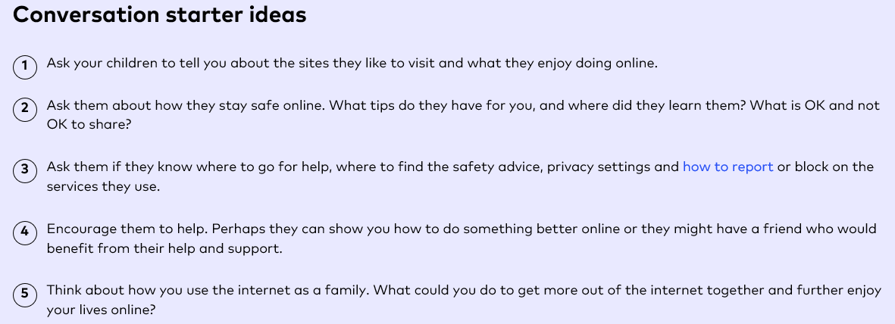
The

Slide 31
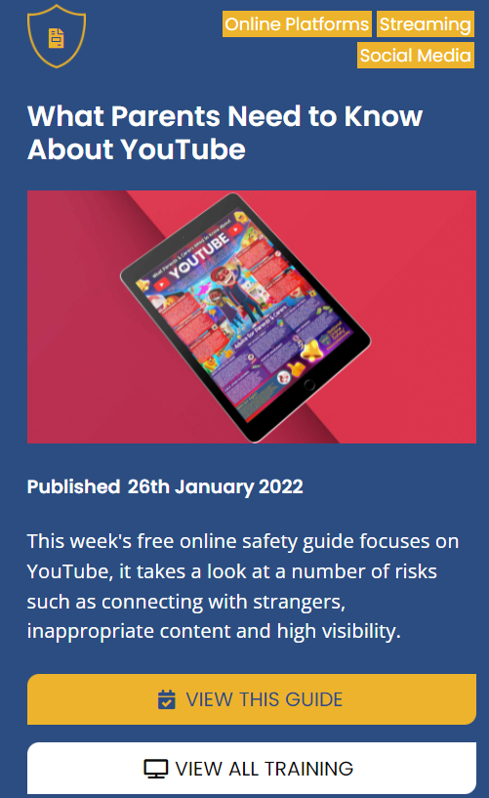
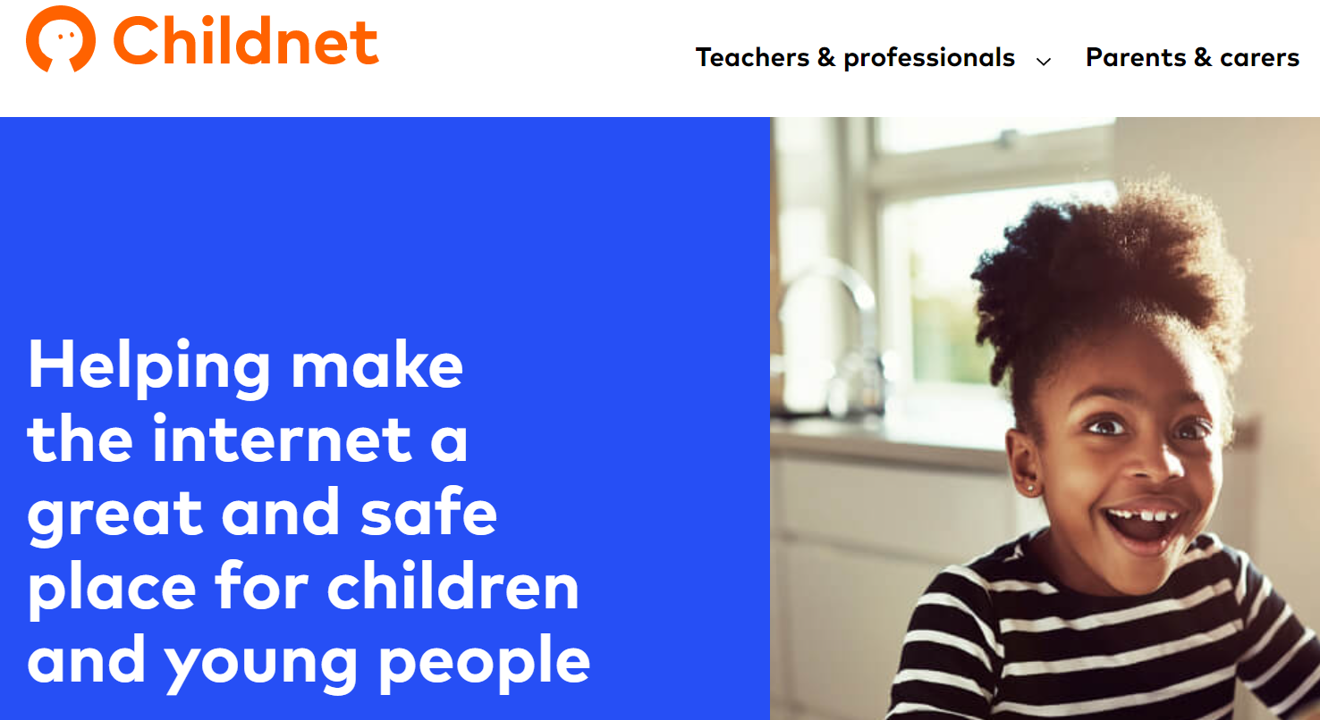
Useful websites
https://www.thinkuknow.co.uk/
https://www.saferinternetday.org/en-GB/
https://nationalonlinesafety.com/guides
https://www.nspcc.org.uk/keeping-children-safe/online-safety/
https://www.childnet.com/

