Slide 1
Phonics
Notes:
Sarah Introduce

Slide 2

Thank you for joining us on this training…

Slide 3
Aims of the session
To give you a brief insight as to how we teach phonics to your children.
Explain how phonics is used in reading and writing.
Look at Letters and Sounds and other techniques used to support children.
Ways you can help your child at home.
Notes:
Sarah

Slide 4
What is Phonics?

Slide 5
What is Phonics?
The learning of a sound system is imperative to the successful development of your child’s reading and writing skills.
Letters and Sounds is the Government recommended scheme to learn phonics.
Notes:
Sarah

Slide 6
Continued…
Words are made up from small units of sound called phonemes. Phonics teaches children to be able to listen carefully and identify the phonemes that make up each word. This helps children to learn to read words and to spell words.
In order to successfully know and use phonic skills they need to know the graphemes and the phonemes they represent, blend with them and segment using them.
Notes:
Sarah

Slide 7
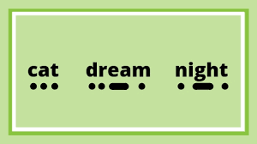

Terminology
Robot or Fred Talk – this is when words are broken down into each discreet sound.
Phoneme or Fred Fingers – This is when the phonemes are counted and the matching number of fingers are held up.
Sound buttons – this is where dots and dashes are marked under a word to show knowledge of the sounds.
Notes:
Sarah

Slide 8
Continued…
Phoneme – this is a discreet unit of sound
Digraph – where two letters make one sound (er, sh, ee)
Trigraph – where three letters make one sounds (igh, ear, air)
Grapheme – the written form of the sound

Slide 9
Blending
Recognising the letter sounds in a written word, for example
c-u-p
and merging or ‘blending’ them in the order in which they are written to pronounce the word ‘cup’
Notes:
Paola

Slide 10
Segmenting
‘Chopping Up’ the word to spell it out
The opposite of blending
Identifying the individual sounds in a spoken word (e.g. h-i-m , s-t-or-k) and writing down letters for each sound to form the word him and stork
Notes:
Paola

Slide 11
The same phoneme can be represented with different graphemes:
  burn
  first
  term
  heard
  work
Notes:
Paola

Slide 12
How do we organise it?
Teach using Letters and Sounds programme
3-5 sessions a week in Reception and KS1
Differentiated activities
Teacher led
Fun, lively, interactive sessions
Range of resources
Notes:
Sarah

Slide 13
How do we teach it?
Short sessions are fast paced and consist of 4 parts:
    Review and Revisit – e.g. Flashcards
    Teach – e.g. introduce new sound, syllables
    Practise – e.g. write or read words or sentences.
    Apply – e.g. play games or activities using the skills or the sounds.
Notes:
Sarah

Slide 14
Phases in Phonics
Notes:
Paola

Slide 15
Phases of Phonics

Slide 16

Purpose of Phase 1
Explore and experiment with sounds and words
Distinguish between different sounds in the environment and phonemes
Learn to orally blend and segment sounds in words
Notes:
Paola

Slide 17
By the end of Phase 1
Children will have experienced a wealth of listening activities including songs, stories and rhymes.
They will be able to distinguish between speech sounds and many will be able to blend and segment words orally.
Some will also be able to recognise spoken words that rhyme and will be able to provide a string of rhyming words, but inability to do this does not prevent moving on to Phase Two as these speaking and listening activities continue.
Notes:
Paola

Slide 18
Phonic sounds – how to say the pure sounds in Phase 2, 3 and 5
Please follow this link to learn how to say the sounds correctly…
Articulation of Phonemes - YouTube

Slide 19
Purpose of Phase 2
Learn 19 phonemes and know the graphemes that represent them.
Use letter names and the sounds they make.
Move on from orally blending and segmenting to blending and segmenting letters to read and spell (maybe with magnetic letters) VC and CVC words
Introduce two syllable words, simple captions and someTricky words.
Notes:
Paola

Slide 20
Phase 2 letter progression
Set 1: s a t p
Set 2: i n m d
Set 3: g o c k
Set 4: ck e u r
Set 5: h b f,ff l,ll ss
Notes:
Paola

Slide 21
Activity…
The order allows the children to begin to make words and segment (separate) and blend (join together) letters after only 1 week.
How many words can you make with these letters?
      s a t p i n
      Now compare this with the first 6 letters of the alphabet…
Notes:
Paola

Slide 22
Purpose of Phase 3
Teach another 25 phonemes and graphemes to go with them.
Learn letter names
Continue to practise blending and segmenting using new phonemes and two syllable words
At this point it does not matter that the children are not spelling accurately, it is about having the confidence to have a go and use the graphemes that they have learned.
Notes:
Paola

Slide 23
25 phonemes taught in Phase 3
Letters
Set 6: j v w x
Set 7: y z,zz qu
Consonant digraphs: ch sh th ng
Vowel digraphs and trigraphs:
ai ee igh
oa oo ar or ur ow oi
ear air ure er

Slide 24
Purpose of phase 4
To consolidate children’s knowledge of graphemes in reading and spelling words containing adjacent consonants and polysyllabic words
Notes:
Paola

Slide 25
Phase 4
• can blend adjacent consonants in words and apply this skill when reading unfamiliar texts, (CCVC, CVCC, CCVCC)
step list clap grasp strap
• can segment adjacent consonants in words and apply this in spelling
Notes:
Paola

Slide 26
Purpose of Phase 5
This is where the fun starts.
Children broaden their knowledge of graphemes and phonemes for use in reading and spelling
Learn new graphemes and alternative pronunciations some of which they will have already encountered in high frequency words
Learn to choose the appropriate graphemes when spelling and begin to build up word specific knowledge
        Look at all these words that have the ai sound in them and note the spelling:
        rain day neigh
        pane they straight
Notes:
Sarah

Slide 27
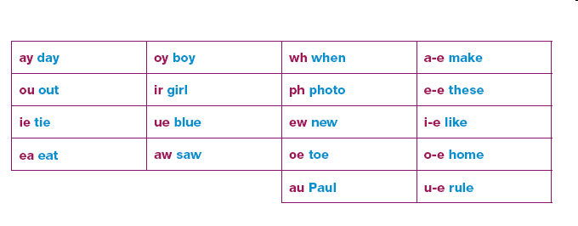
New Graphemes for Reading
Notes:
Sarah

Slide 28
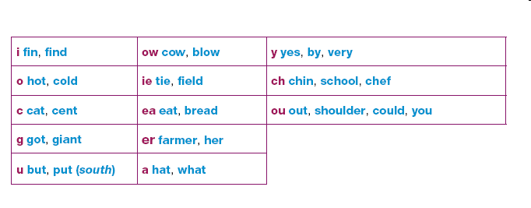
Alternative Pronunciations
Notes:
Sarah

Slide 29
Phase 6
This last phase looks more at spelling rules and patterns and gives children a love of words.
During this phase the children are encouraged to investigate words, sounds and patterns.
In Year 2 – the children have the independence to find patterns themselves and they always find words that do not follow those patterns!
Notes:
Sarah

Slide 30
Tricky words or High Frequency Words
Tricky words cannot be ‘sounded-out’
Camera- take a photograph
Helpful actions and songs
Look, Say, Cover, Write, Check
Practise, practise, practise

Slide 31
Phonics Check in Year 1

Slide 32
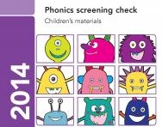

Year 1 Phonics
Screening Check
Notes:
Sarah

Slide 33
What is the Phonics Screening Check?
Children in Year 1 throughout the country will all be taking part in the phonics screening check during the same week in June.
If children did not pass the test in Year 1, they will retake the test in Year 2.
Notes:
Sarah

Slide 34
What happens during the test?
The test contains 40 words.
Each child will sit one to one and read each word aloud.
The test will take approximately 10 minutes per child; although all children are different and will complete the check at their own pace.
The list of words the children read in a combination of 20 real words and 20 nonsense words.
Notes:
Sarah

Slide 35
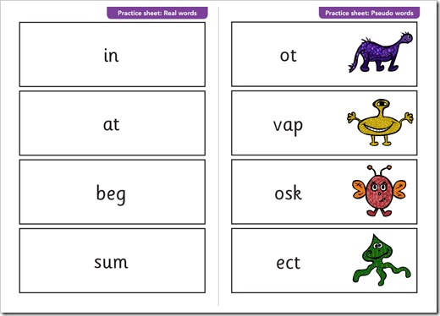
Real and ‘Nonsense’ Words
Notes:
Sarah

Slide 36
Helping at Home
We will be sending home a leaflet in a Phonics Pack.
This will also include a List of ideas including games, apps and websites.
Have a look – use some of the ideas and find the children’s favourites.
Notes:
Paola

Slide 37
Any Questions?
Please email your class teacher if you have any questions on our phonic scheme:
Mrs Daniel – staff16@croft.staffs.sch.uk
Mrs Richards – staff15@croft.staffs.sch.uk
Mrs Astley – staff31@croft.staffs.sch.uk
Notes:
Paola

